Slide 1

City of Beaverton
SharePoint Solution Showcase

Slide 2

City of Beaverton, Oregon – SharePoint
Who They Are
The City of Beaverton, Oregon, is a dynamic municipality known for its diverse community and commitment to innovation. To enhance its digital infrastructure, the city partnered with Affirma, a leading technology consultancy.
What We Did
Affirma assessed Beaverton's SharePoint 2016 On-Premises environment, conducted a thorough inventory, and developed detailed migration planning documents for transitioning to SharePoint Online (SPO) Modern. Phase 2 involved executing the migration from SharePoint 2016 to SPO, setting up hub sites and multiple department sites, and implementing forms and workflows to streamline operations.
The Results
Affirma provided the City of Beaverton with a clear migration plan and a complete SharePoint inventory, laying a solid foundation for Phase 2. The anticipated outcomes include a successful migration to SPO, enhanced collaboration through new hub and department sites, and improved operational efficiency through tailored forms and workflows.

Slide 3
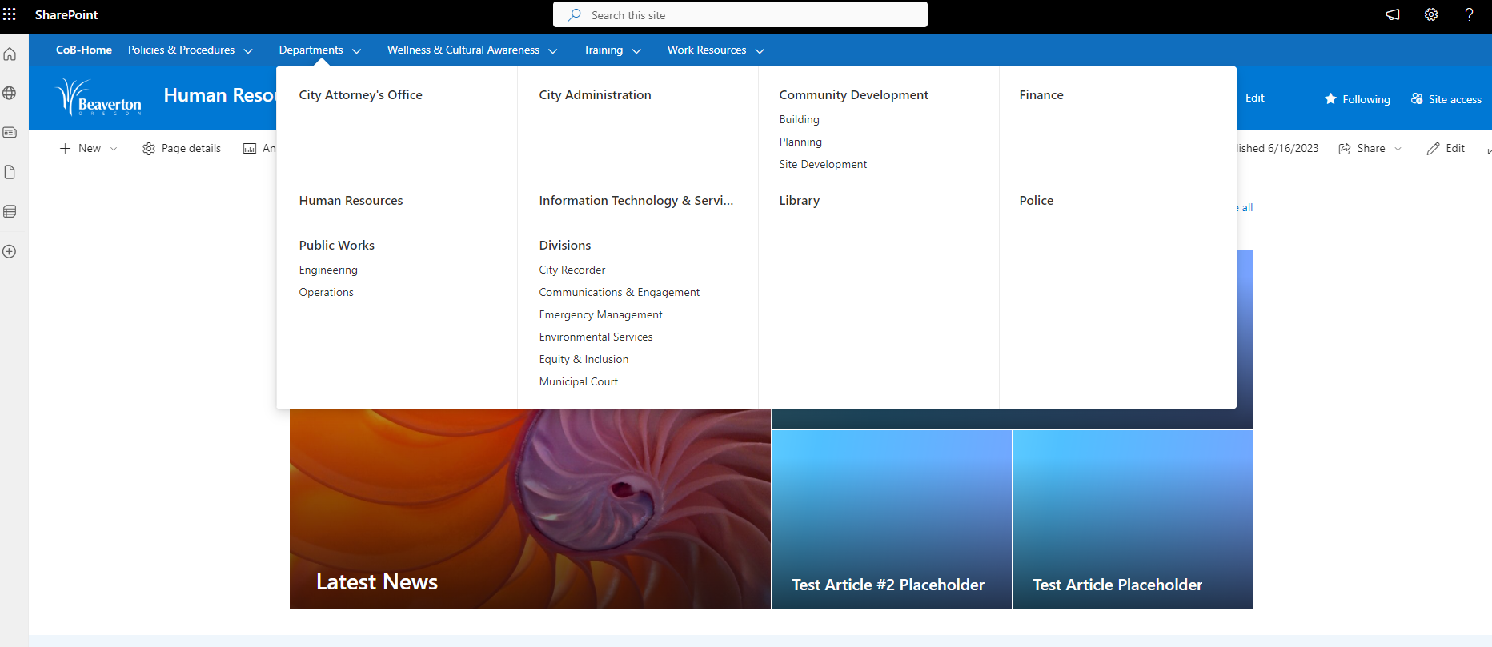
City of Beaverton SharePoint “Departments Menu”

Slide 4
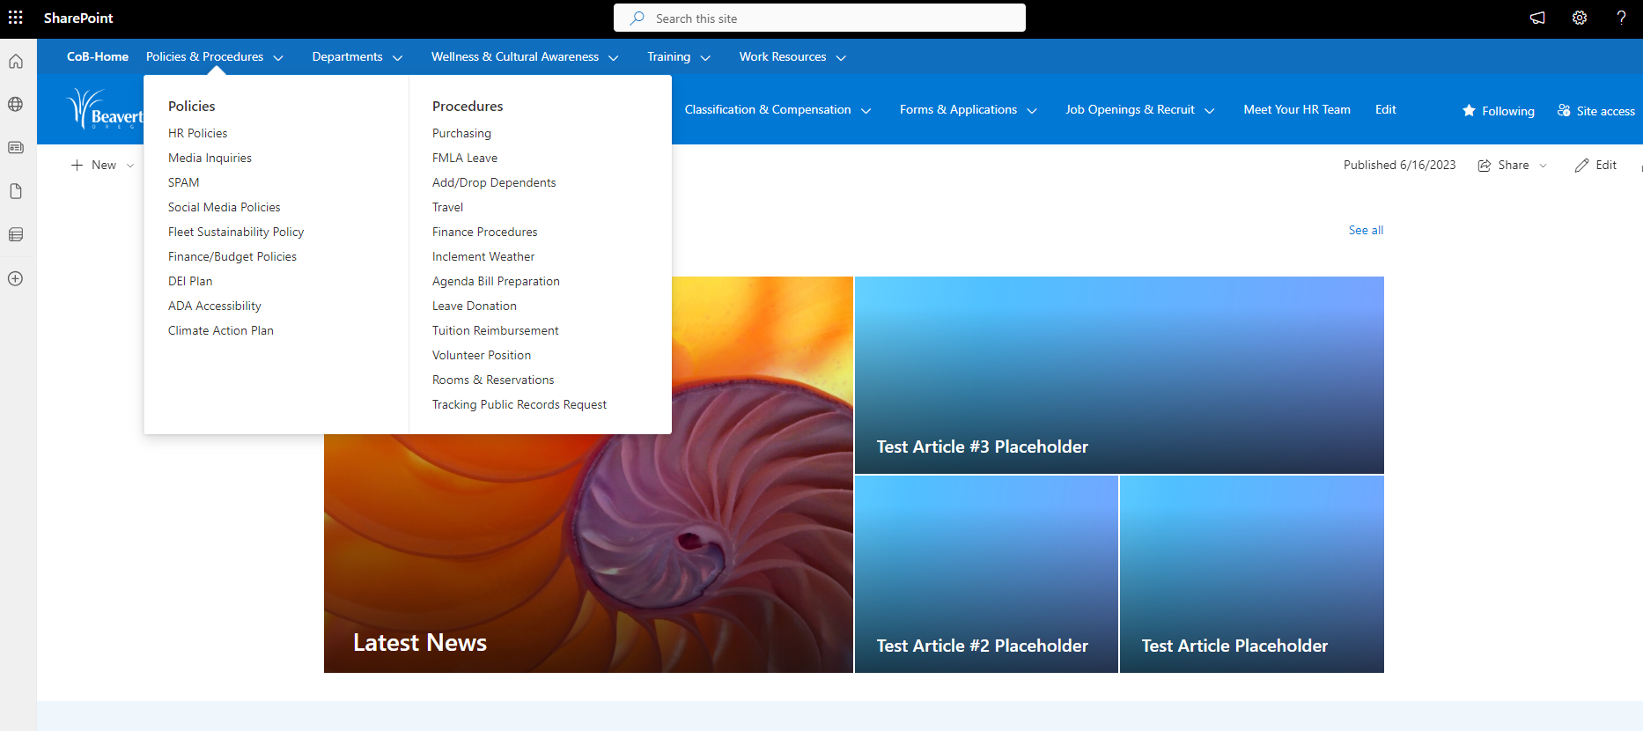
City of Beaverton SharePoint “Policies & Procedures Menu”

Slide 5
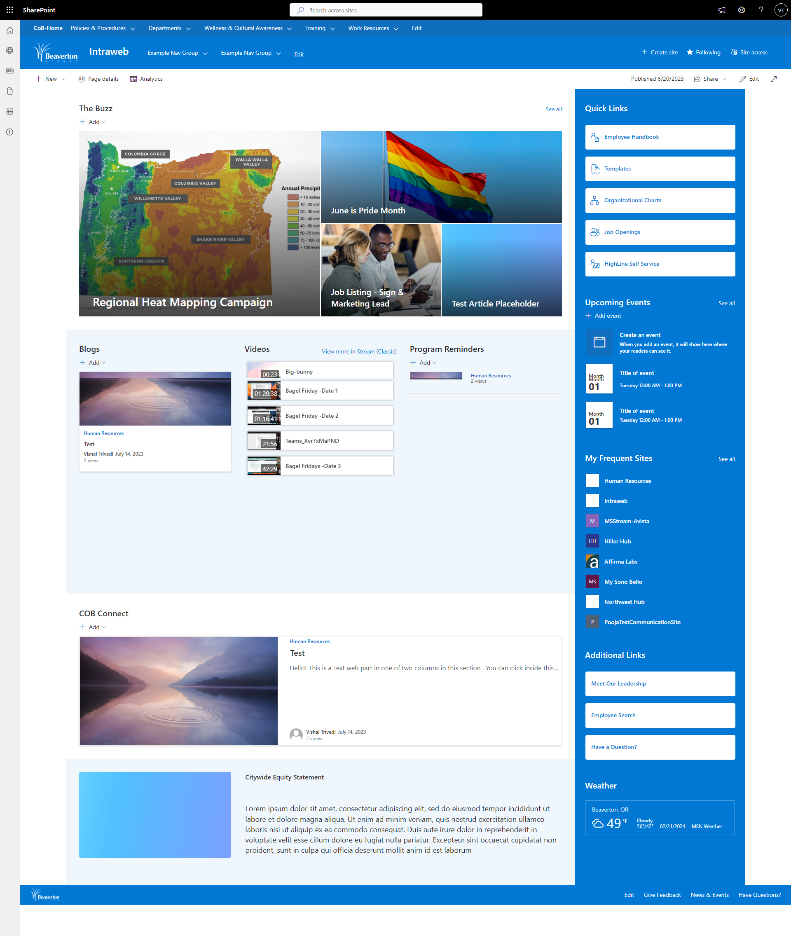
City of Beaverton SharePoint “Home Site Two”

Slide 6
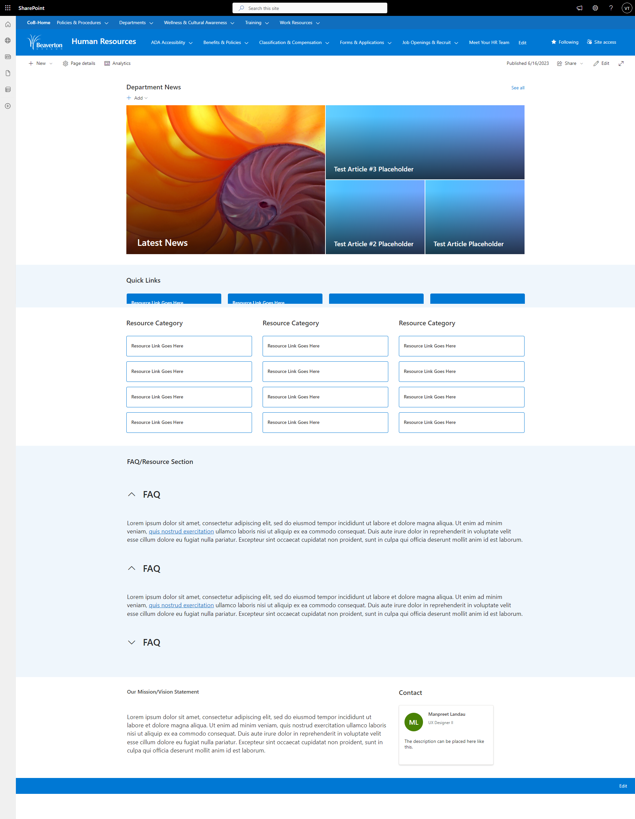
City of Beaverton SharePoint “HR Department Site”

